Slide 1
SCE16-0555 OFFLINE WEB SUBTITLE EDITOR
Tan Yan Ling
U1422381G
15th MAY 2018
Notes:
Good Afternoon, I am Tan Yan Ling, and today I will be presenting my Final Year Project on Offline Web Subtitle Editor.

Slide 2
AGENDA
Transcribing Tools
Motivation
Subtitle Editor
Design Architecture
Features and Advantages
Summary
Notes:
This is the agenda for today’s presentation. where I will be focusing on these points throughout the whole presentation. To allow you to understand more about this project, I will briefly go through the usage of transcribing tools.

Slide 3

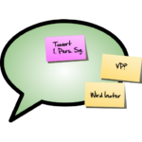
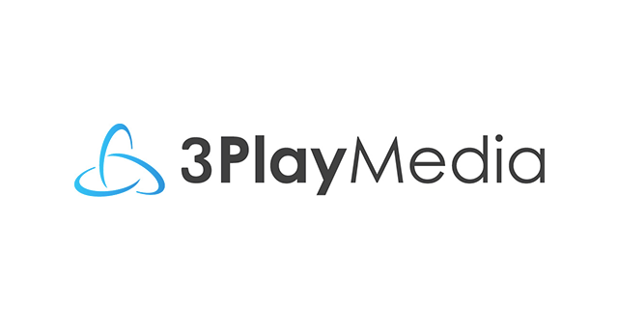



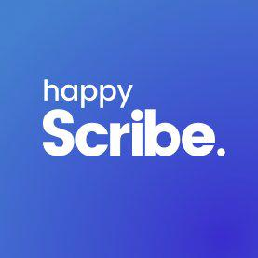


Notes:
These are some examples of the existing transcribing tools in the market, which transcribe speech into text as well as to modify the transcript to achieve high accuracy. Some of these transcribing tools are software applications where users are required to download them, whereas some are web-based applications with the use of web browsers. There are two problems spoken previously, and in this project, I will be focusing on achieving a more complete transcript with fewer errors after human intervention.

Slide 4
Transcript
Transcripts can be produced manually or using ASR technology.
100% is not attainable, due to the optimal conditions set by the system.
Human correction and vetting are required to be done on transcript.
Notes:
Transcripts can either be produced manually or by using automatic speech recognition technology. For this project, the transcripts are auto-generated by the audio speech recognition systems. With the current technology implemented, 100% accuracy is still not yet attainable, hence they require human correction and vetting is to be done on the transcript.

Slide 5
MOTIVATION
Absence of a well-designed subtitle editor.
Editors too simple with minimal features.
More time required on processing work.
Keying the keywords.
Doing time stamping of words.
Notes:
The motivation behind this subtitle editor is there is an absence of a well-designed web-based subtitle editor currently in the market. Certain editors are very simple with minimal features that do not provide users with much features. Hence, users require more time on processing work such as inputting the correct words, by typing in the keyword and doing time stamping of words.

Slide 6
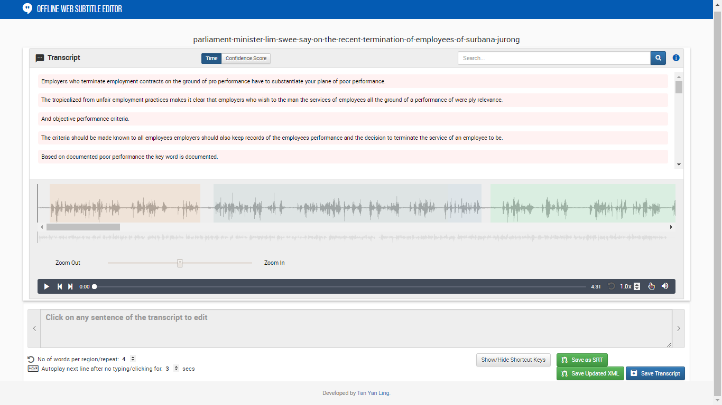
Notes:
Now, I will give you a short overview on the Subtitle Editor. As we can see, the subtitle editor is packed with necessary features such as searching keywords throughout the transcript in the search box as seen in the top right corner, as well as highlighting the low confidence words by clicking on the confidence score on the transcript panel.

Slide 7
Overview of editor
Designed to cater for novice and expert users.
Use a native HTML5 player and JavaScript.
Easily deployed to web browsers or Cloud.
Save time and cost.
Need not install any software.
Notes:
The subtitle editor is a web-based application, that is designed to cater for novice and expert users. Some transcribing tools have many features which may confuse novice users since they are not frequently exposed to these applications. A native HTML5 player and JavaScript are used which can be easily deployed to web browsers or Cloud. It also saves time and cost as there is no need in installing any software to operate the system and worrying about the incompatibility with other machines or operating systems. The key innovation behind this is to allow users to work with high efficiency and usability from learning their work patterns.

Slide 8
DEMO ON SUBTITLE EDITOR
Notes:
The application is designed in web-based format. And here is a short demo on how the subtitle editor works, and I will give a brief description on the application itself.
First, user could upload the media file along with the transcript file they want to modify. They could either browse through the folders and select, or drag the relevant file directly into the dotted enclosing box. Upon selecting the two files, user will be directed to the main page of the subtitle editor application. From the application seen above, the title of the xml file is shown at the top of the web, followed by the transcript text, that is imported from the xml file. Users could filter the sentences in the transcript according to the time starting from the beginning or the confidence score, where the top sentence is mostly the sentence with the most number of inaccurate words.

Slide 9
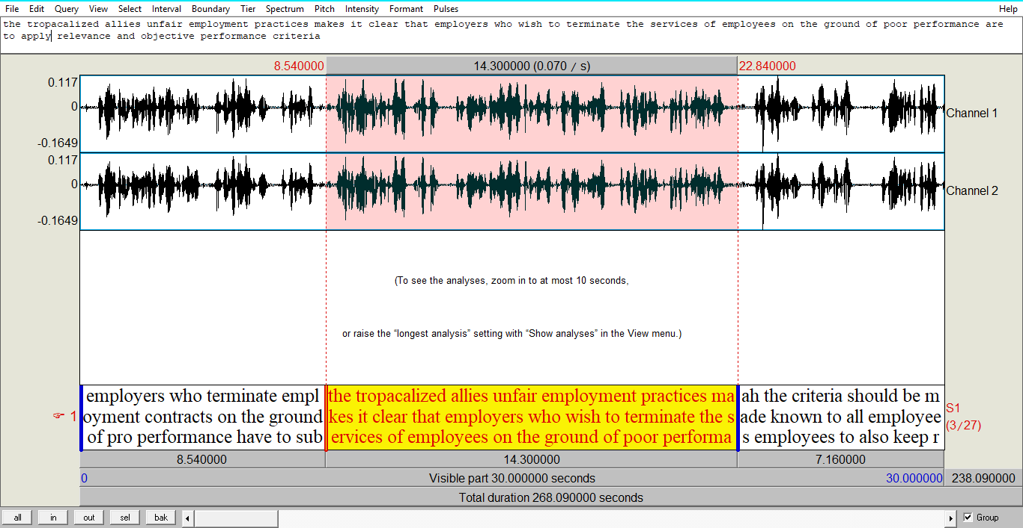
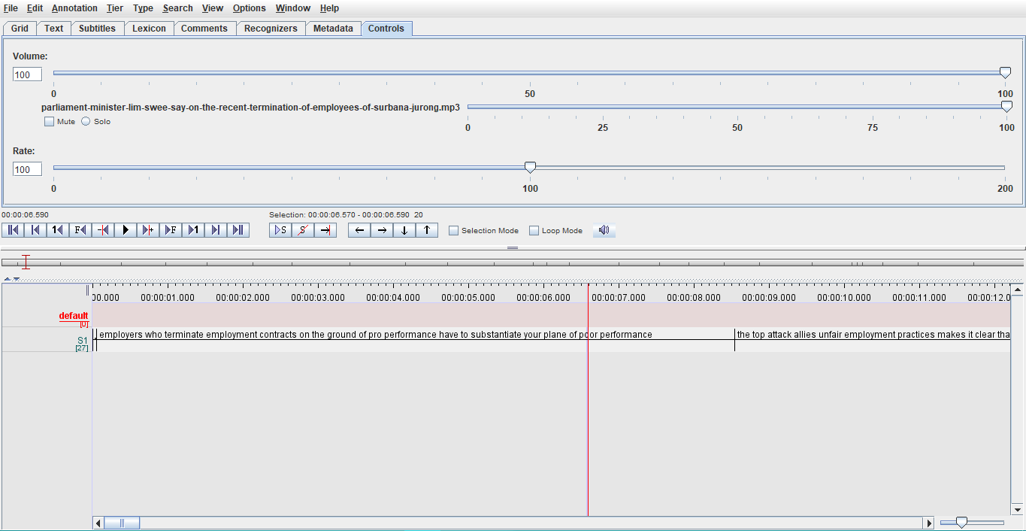
COMPARISON
PRAAT
SUBTITLE EDITOR
ELAN
Notes:
Now, I will compare this application with Praat and ELAN. Praat and ELAN are software applications which require users to download them. Similar to our application, waveform visualization is shown in Praat, whereas for ELAN, there is no waveform visualization. There is no pausing of playback and auto-looping for Praat which makes it difficult for users since they are unable to pause and restart the section they want to listen. They have to play the whole section of that sentence before reselecting it again to listen. As for ELAN, it is more suitable for experienced users, who have a clear understanding on the functions and features. Revision history is not equipped which makes it even harder for users since undoing of amendments are hard to retrieve back.

Slide 10
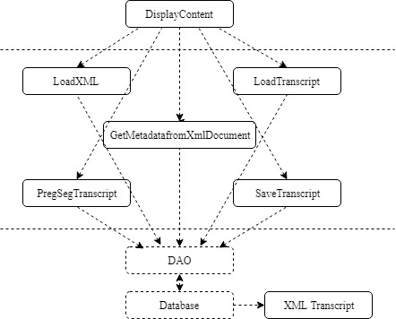
DESIGN ARCHITECTURE
Model-View-Controller (MVC):
Presentation layer
Application logic layer
Persistent data layer
New components can be added without
creating interference to other layers.
Notes:
The design architecture implemented for this application is the Model-View-Controller, in short MVC in PHP. This architecture is used to ensure loose coupling and high internal cohesion between components and layers. The benefit of using this is that new components could be added in the respective layer without creating interference to the other layers.
The top layer is the presentation layer where it is the website itself, followed by the application logic layer where all the controllers are inside the player, and lastly, the persistent data is the database stored.

Slide 11
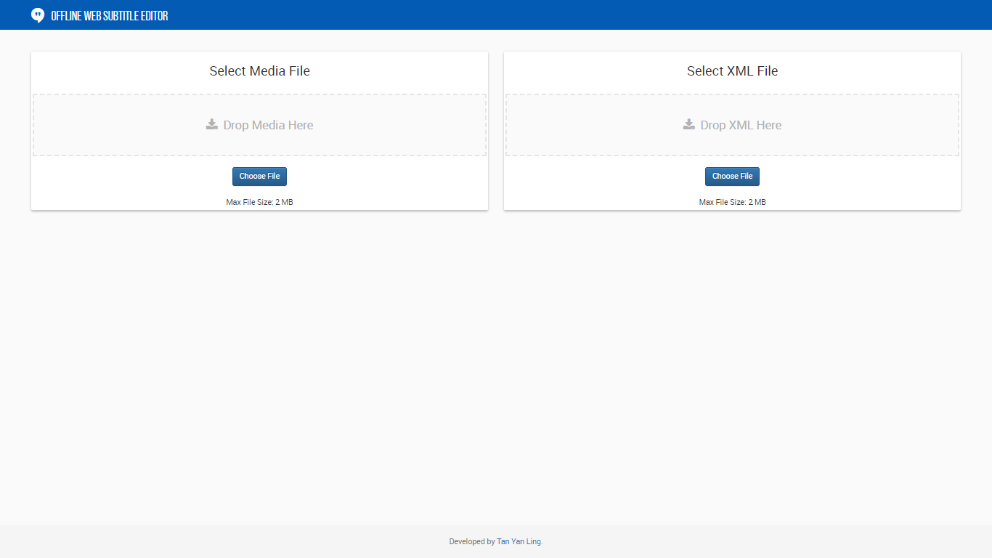
Startup page
Notes:
This is an overview of the startup page where there is a drag and drop function to select the media and transcript file. Ajax and JavaScript are used in this component.

Slide 12
MODIFICATIONS DONE TO
SUBTITLE EDITOR
Notes:
Now I will be talking about the modifications done to the application to provide a more conducive way to use.

Slide 13
Limit words per sentence
A sentence spoken may be lengthy.
Difficulty for users to focus on the current word.
Limit number of words per sentence.
Notes:
The feature I will be talking is to limit the number of words per sentence. Some sentences spoken may be lengthy, having a lot of words, which is difficult for users to concentrate on the current word if they are distracted. Hence, Hence, we set 30 words as the limit for each sentence.

Slide 14
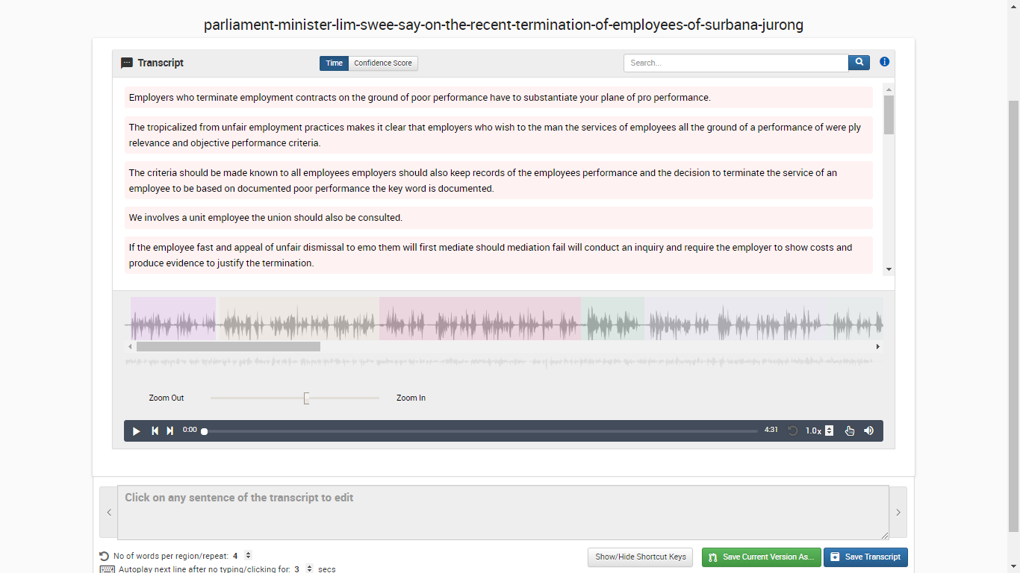
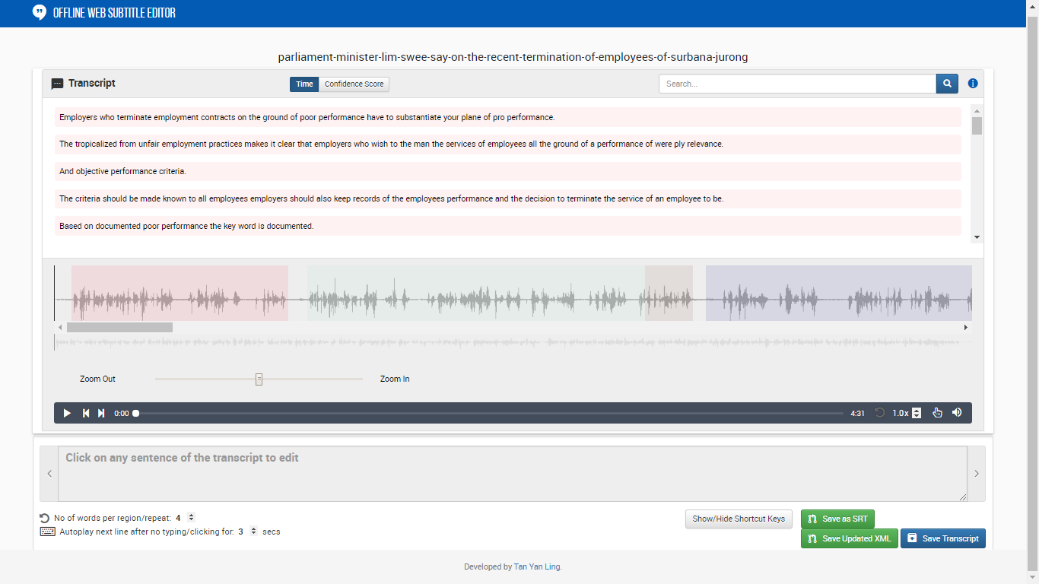
Notes:
The diagram on the left is before modification where there are more than thirty words in this sentence. After modification, the sentence is split into two sections as shown in the diagram on the right.

Slide 15
Limit words per sentence
Advantages:
A shortened sentence would be more feasible.
Provide comfort to users.
Notes:
a shortened sentence would be more feasible to provide comfort for users. Another way to follow the playback, users could also click on the current sentence spoken, where it will reflect on the transcript editing textbox, where the words are highlighted in yellow.

Slide 16
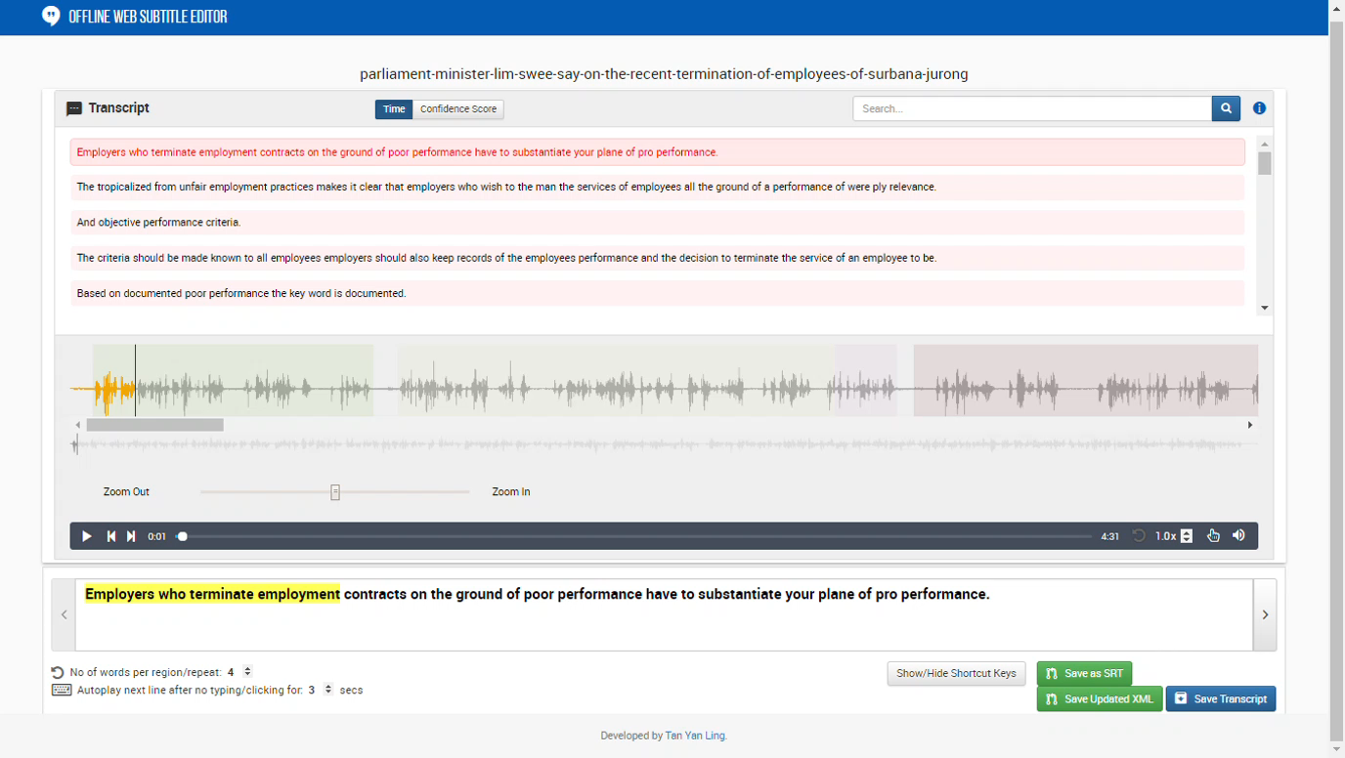
Limit words per sentence

Slide 17
SEARCH BOX
16
Notes:
Another feature is the implementation of a search box as you can see on the top right corner of the screen.

Slide 18
SEARCH BOX
DEMO
Notes:
DEMO [for example, I will search a word ‘perform’ and the results are shown in the transcript screen. The sentence with the most number of occurrences of that word will be shown at the top, followed by the least number of occurrences.]

Slide 19
SEARCH BOX
Advantages:
Search throughout the transcript with ease.
Look for appropriate sentence to edit.
Sorting is updated accordingly.
Notes:
This implementation is done using JavaScript, and it is to ensure users are able to search for keywords easily, and look for appropriate sentence to edit. Upon searching throughout the transcript, sorting is updated according to the search result.

Slide 20
playback PAUSED UPON EDITING
By inputting any character, playback is being paused.
Notes:
Playback being paused automatically upon editing is included as a feature. By inputting any character, the playback is automatically paused to allow users to do their changes on the transcript without being rushed.

Slide 21
playback PAUSED UPON EDITING
DEMO
Notes:
DEMO [From here, you could see that the playback is being paused at the moment. There is an inaccurate word in this section. So I am required to change this word from ‘pro’ to ‘poor’. So now I am going to play the playback and edit when the playback is still playing. As we can see, the playback is paused when I insert a character. ]

Slide 22
playback PAUSED UPON EDITING
Advantages:
This gives users ample time to make changes.
Users could resume the playback by clicking on the play button or F1.
Mainly for novice users.
Notes:
The advantage is that it gives users ample time to edit the changes made. Users could resume playback by clicking on the play button or F1. This feature is included mainly for novice users who are unable to keep up with the time allocated to make changes.

Slide 23
Save transcript
Save transcript in two ways:
In XML format.
In SRT format.
Notes:
Next feature I am going to talk about is the saving of transcript in either XML or SRT format. Previously, I have talked about how we import transcript in the XML format into the application.

Slide 24
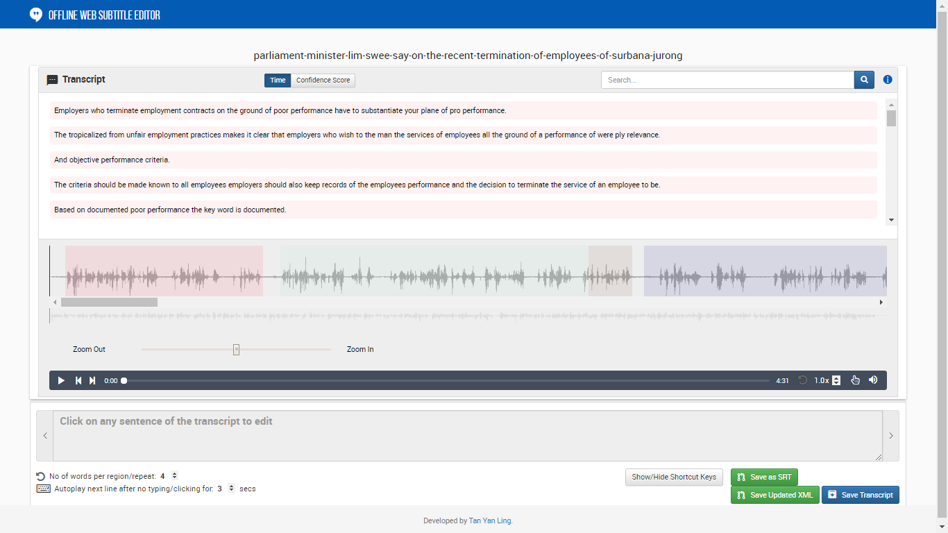
Notes:
We could also export by saving the modified version of the transcript in XML format using either of these buttons as shown in the bottom right corner.

Slide 25
Save transcript in XML FORMAT
DEMO
Notes:
I will first talk about the XML format. So the green button, named ‘Save Updated XML’.

Slide 26
Save transcript in XML FORMAT
Downloaded file is stored in the ‘Downloads’ folder.
Users could upload the newer version in the startup page in another setting.
Notes:
upon clicking it, the modified version will be downloaded in the ‘Downloads’ folder. Users could upload the newer version of the transcript. The modified version will include _V1 in the title of the file.

Slide 27
Save transcript in SRT FORMAT
DEMO
Notes:
As for the SRT format, the imported version of the transcript could be downloaded.

Slide 28
Save transcript in SRT format
Only the imported version of the uploaded transcript could be downloaded.
Alert message will be prompted if the transcript undergoes editing.
Downloaded file is stored in the ‘files’ folder.
Prevent more errors from arising due to improper upload of transcript.
Notes:
Upon modification done to the transcript upon editing, the application is unable to recognize the modification done. Hence, an alert message will be prompted out as shown above. To save the modified version of SRT, users are required to save the modified version of XML transcript and select that version in the startup page, and save the SRT format instantly. This is done to ensure that fewer mistakes will arise due to the proper upload of XML transcript. The downloaded SRT file will be stored in the ‘files’ folder as shown here.

Slide 29
Save transcript in SRT format
Advantages:
Prevent more errors from arising due to improper upload of transcript.
One of the most common transcript format used in transcribing tools.
Easily integrated to other applications.
Notes:
The implementation of the SRT transcript is done as it is one of the most common transcript format used in existing transcribing tools, which makes it easier to integrate to other applications.

Slide 30
SUMMARY
An iterative and responsive Offline Web Subtitle Editor using Java approach.
An experience without the use of mouse, with just keyboard shortcuts.
Some features integrated in the application not seen in existing tools.
Notes:
Now I will be talking about the summary of this project. An iterative and responsive Offline Web Subtitle Editor is created with the use of Java approach. Users are able to experience without the use of mouse by using keyboard shortcuts to navigate around the applications. This application is suitable to cater for beginners as well as expert users. Some features being integrated in this application are not seen in existing transcribing tools.

Slide 31
Technical difficulties
When required to make changes dynamically, restricted to JavaScript and JQuery.
Fewer features implemented due to application being web-based.
Notes:
Some technical difficulties faced are that if it is required to make changes dynamically, there is a restriction to using JavaScript and Jquery to reflect the changes immediately. And since this is a web-based application, there are fewer features that can be implemented as compared to software applications due to functionalities of the programming language.

Slide 32
FUTURE WORK
Partial waveform to be visualized.
Lack of waveform visualization for video files.
Multiple sentences being highlighted.
Notes:
Partial waveforms cannot be visualized due to the limitation of the zoom function that the plugin is integrated. There is a lack of waveform visualizations for video files. If users were to modify a large segment of the transcript, the application could not support the multiple modifications, causing multiple sentences to be highlighted.

Slide 33
THANK YOU!

